Slide 1
IMSE 802 Supply Chain Operations and Decision Making
Lecture 5
Chapter 4
Supply Chain Technology

Slide 2
Supply Chain Technology
Supply Chain Technology
Decision Making Framework
Multiple Attribute Decision Making
Line Item Deletion/Retention

Slide 3
Supply Chain Technology
Information technology and traditional supply chain technologies are merging
Key are changes in how technologies are managed with the new capabilities
Robots and smart machines are changing how factories and warehouses operate
Technologies include robots, driverless vehicles, drones, manufacturing operations, pick, pack and ship operations are all being automated.

Slide 4
Supply Chain Technology
Key components of information technology
Cloud computing
Data transmission (EDI and XML)
Databases and business analytics
Application systems

Slide 5
Supply Chain Technology
Cloud Computing
A combination of technologies creates cloud computing
The combination of technologies such as the Internet, Web browsers, server virtualization, and open source software provides these capabilities.
Cloud computing describes the combinations of these technologies
Examples are combinations of outsourced data centers, application packages like ERP and CRM, etc.
The exact definition is still evolving

Slide 6
Supply Chain Technology
Cloud Computing
Two working definitions:
“Consumer and business products, services, and solutions delivered and consumed in real time over the Internet” – Frank Gens, “Defining ‘Clout Services:’ and IDC update,” IDC exchange

Slide 7
Supply Chain Technology
Cloud Computing
Two working definitions:
“A broad array of Web-based services aimed at allowing users to obtain a wide range of functional capabilities on a ‘pay-as-you-go’ basis that previously required tremendous hardware/software investments and professional skills to acquire” – Jeff Kaplan, “Simplifying the Term ‘Cloud Computing,’” Datamation.com Blog (June 25, 2009)

Slide 8
Supply Chain Technology
Cloud Computing
Three characteristics
Practically unlimited computing resources
No long-term commitments
Pay-as-you-go cost structure

Slide 9
Supply Chain Technology
Cloud Computing
Benefits
Up to date technology
Lower price points
Serve large numbers of customers
Key information available on laptops and smartphones

Slide 10
Supply Chain Technology
Data Transmission (EDI)
Electronic data interchange (EDI) transmits common types of data between companies that do business with each other

Slide 11
Supply Chain Technology
Data Transmission (EDI)
First deployed in the 1980s to automate back-office transactions
Purchase orders - “850” transactions
Invoices – “810” transactions
Advanced shipment notices – “ 856” transactions
Backorder status – “855” transactions
Run on mainframes using value-added networks (VANs) to connect with other trading partners

Slide 12
Supply Chain Technology
Data Transmission (EDI)
Cost effective to communicate with businesses
Standards have been developed for a large number of transactions
Can be now run on any type of computer
Can use the internet for data communication as well as VANs
Costs have decreased over time

Slide 13
Supply Chain Technology
Data Transmission (XML)
XML (eXtensible Markup Language) is a technology that is being developed to transmit data in flexible formats between computers
XML is extensible can be used to communicate a wide range of data and processing
The exact data transactions and processing sequences don’t have to be defined like EDI

Slide 14
Supply Chain Technology
EDI and XML are Merging
Currently they are merging into a hybrid system
Many companies are replacing EDI with XML
Longer term, EDI will be consumed by XML, once XML standards are agreed upon and spread
XML allows for more free form communication, like human interaction

Slide 15
Supply Chain Technology
Databases and Business Analytics
A database is an organized grouping of data that is stored in an electronic format.
Relational databases store groupings of related data in individual tables
They provide the use of standard query language (SQL) to retrieve the data
A model of the business process in how it collects and stores data

Slide 16
Supply Chain Technology
Databases and Business Analytics
The data model captures the balance of highly aggregate data and highly detailed data to provide meaningful data back to the customer.
Database transactions are stored and processed in the database.
This can happen in real-time or can be batch processed at a given point in time.

Slide 17
Supply Chain Technology
Databases and Business Analytics
Different views of the data are created and provided to meet reporting needs
These views are specific or aggregated data and are intended to help individuals do their job.
Different views of the same data can be provided based on different functional use.

Slide 18
Supply Chain Technology
Application Systems
Different supply chain application systems are created by combining processing logic to manipulate and display data.
This information is used to capture, communicate, store and retrieve that data.
Several different types of systems support supply chain operations

Slide 19
Supply Chain Technology
Application Systems
Enterprise Resource Planning (ERP)
Gathers data from across multiple functions in a company
Monitors orders, production, schedules, raw material purchases and finished goods inventory
Supports a process-oriented view of the business that cuts across different functional departments.
Comes in modules that can be installed on their own or in combination with other modules such as finance, procurement, manufacturing, logistics, etc.

Slide 20
Supply Chain Technology
Application Systems
Procurement Systems
Focus on procurement activities between the company and the suppliers.
Streamline the procurement process
Track parts, prices, purchasing history, etc.
Allows people to compare the price and performance capability of different suppliers

Slide 21
Supply Chain Technology
Application Systems
Advanced Planning and Scheduling
Advanced planning and scheduling (APS) systems are highly analytical applications whose purpose is to address plant capacity, material availability, and customer demand.
APS systems then produce production schedules over time.
Base calculations on input-level ERP data or legacy system
Use linear programming techniques or other sophisticated algorithms.

Slide 22
Supply Chain Technology
Application Systems
Transportation Planning Systems
Calculate what quantity of materials should be brought to what locations at what times.
Enable the comparison of transportation modes and costs
Transportation plans are generated from these systems.
Content vendors provide the data needed by the systems such as mileage, fuel costs, and shipping tariffs

Slide 23
Supply Chain Technology
Application Systems
Demand Planning
Use techniques and algorithms to forecast demand
Information used includes historical data, promotions, seasonality and market trends to create forecast models.
Also included is revenue management which lets companies experiment with different pricing mixes.

Slide 24
Supply Chain Technology
Application Systems
Customer Relationship Management (CRM)
Related to servicing customers
Related to finding new customers
Track buying patterns and histories of customers
Consolidate customer-related data so that it is quickly accessible

Slide 25
Supply Chain Technology
Application Systems
Sales Force Automation
Allows companies to better coordinate and monitor the activities of its sales force
Automate scheduling sales calls and follow-up visits
Automate preparing quotes and proposals for customers and prospects.

Slide 26
Supply Chain Technology
Application Systems
Supply Chain Management (SCM)
Suites of different supply chain applications that are tightly integrated with each other
An example might include planning, transportation, scheduling, inventory demand planning, etc.
Relies on ERP systems to provide data
Typically has analytical capabilities

Slide 27
Supply Chain Technology
Application Systems
Inventory Management Systems
Supports inventory management functions
Includes demand patterns, inventory levels, economic order quantities, etc.
Used to find the right balance of carrying costs and inventory levels to minimize lost sales.

Slide 28
Supply Chain Technology
Application Systems
Manufacturing Execution System (MES)
Focused on carrying out the production activities in a facility.
Less analytical than an advanced planning system
Produces short-term executable schedules
Operationally focused

Slide 29
Supply Chain Technology
Application Systems
Transportation Scheduling Systems
Operationally based system
Focused on daily operations
Produce short-term transportation and delivery schedules

Slide 30
Supply Chain Technology
Application Systems
Warehouse Management System (WMS)
Supports daily warehouse operations
Provides capabilities to efficiently run the warehouse
Tracks inventory levels and stocking locations within the warehouse
Supports the activities required to pick, pack and ship product to customers

Slide 31
Supply Chain Technology
New Supply Chain Technology
Complementary Supply Chain Technologies
Industrial robots
Drones and driverless vehicles
Artificial intelligence (AI)
Internet of Things (IoT) and big data
Real-time product information
3D printing and additive manufacturing

Slide 32
Supply Chain Technology
Complementary Supply Chain Technologies
Industrial robots
An industrial robot is a manipulator designed to move materials, parts, and tools and perform programmed tasks in manufacturing and production
Can be used for dangerous or unsuitable tasks
They are reaching new levels of sophistication and affordability
Can be connected for complex manufacturing
Robots typically communicate with a central system for programming and scheduling

Slide 33
Supply Chain Technology
Complementary Supply Chain Technologies
Drones and Driverless Vehicles
“Essentially, a drone is a flying robot. The aircrafts may be remotely controlled or can fly autonomously through software-controlled flight plans in their embedded systems working in conjunction with onboard sensors and GPS. (TechTarget, “IoT Agenda, Drone,” http://internetofthingsagenda.techtarget.com/definition/drone)
Can be used to move products and parts in a supply chain.

Slide 34
Supply Chain Technology
Complementary Supply Chain Technologies
Artificial Intelligence (AI)
“Artificial intelligence (AI) is intelligence exhibited by machines. In computer science, the field of AI research defines itself as the study of “intelligent agents”: any device that perceives its environment and takes actions that maximize its change of success at some goal. (Wikipedia, 2017, https://en.Wikipedia.org/wiki/Aritificial_intelligence#cite-ref-Intelligent_agents_1-1)
Machine learning will continue to enhance supply chain operational advancements.

Slide 35
Supply Chain Technology
Complementary Supply Chain Technologies
Internet of Things (IoT) and Big Data
“The interconnection via the Internet of computing devices embedded in everyday objects, enabling them to send and receive data. (Google online dictionary definition from Google search on “Internet of Things”)
“Extremely large datasets that may be analyzed computationally to reveal patterns, trends, and associations, especially relating to human behavior and interactions. (Google online dictionary definition from Google search on “Internet of Things”)

Slide 36
Supply Chain Technology
Complementary Supply Chain Technologies
Real-Time Product Information
Product information is composed of descriptive data about the product itself plus tracking data that traces the movement of a product through the supply chain.
Currently, there is one organization called GS1 that sets product categorization standards

Slide 37
Supply Chain Technology
Complementary Supply Chain Technologies
Real-Time Product Information
Previously, there were two product codes called the Universal Product Code (UPC) and European Article Number (EAN)
From 2005 onward, the format was combined into one 14-digit UPC in North America and the 13-digitit EAN plus check digit.
GS1 also introduced the Global Trade Item Number (GTIN) which refers to the fact that there is now just one 14-digit numbering scheme

Slide 38
Supply Chain Technology
Complementary Supply Chain Technologies
Real-Time Product Information
The GTIN is part of a global item-numbering scheme called the Electronic Product Code (EPC) that GS1 had introduced. This is comprise of four components:
A version code for the EPC
A manager code that tells who created the EPC
An object class that defined the type of item or service
A serial number that identifies the specific item or service
In essence, it is a GTIN with a serial number attached

Slide 39
Supply Chain Technology

Slide 40
Supply Chain Technology
Complementary Supply Chain Technologies
3D Printing and Additive Manufacturing
“3D printing is also know as additive manufacturing (AM), refers to processes used to create a three-dimensional object in which layers of material are formed under computer control to create an object.” (Wikipedia, “3D Printing,” https://en.Wikipedia.org/wiki/3D_printing)
Can manufacture a wide range of products on demand
Generates significant improvements in inventory management
Can improve their customer service levels

Slide 41
Supply Chain Technology
Complementary Supply Chain Technologies
Simulation Modeling
“Simulation modeling is the process of creating and analyzing a digital prototype of a physical model to predict its performance in the real world. Simulation modeling is used to help designers and engineers understand whether, under what conditions, and in which ways a part could fail and what loads it can withstand. (Wikipedia, “Simulation Modeling,” https://en.Wikipedia.org/wiki/Simulation_modeling)

Slide 42
Supply Chain Technology
Complementary Supply Chain Technologies
Simulation Modeling
Supply chain decisions have significant consequences for company operations and profitability
Simulation modeling software allows people to create models of things such as a factory or delivery vehicle or the entire supply chain network
Different inputs and parameters can be tested to observe what happens.
Better decisions can be made at a much lower risk by simulation.

Slide 43
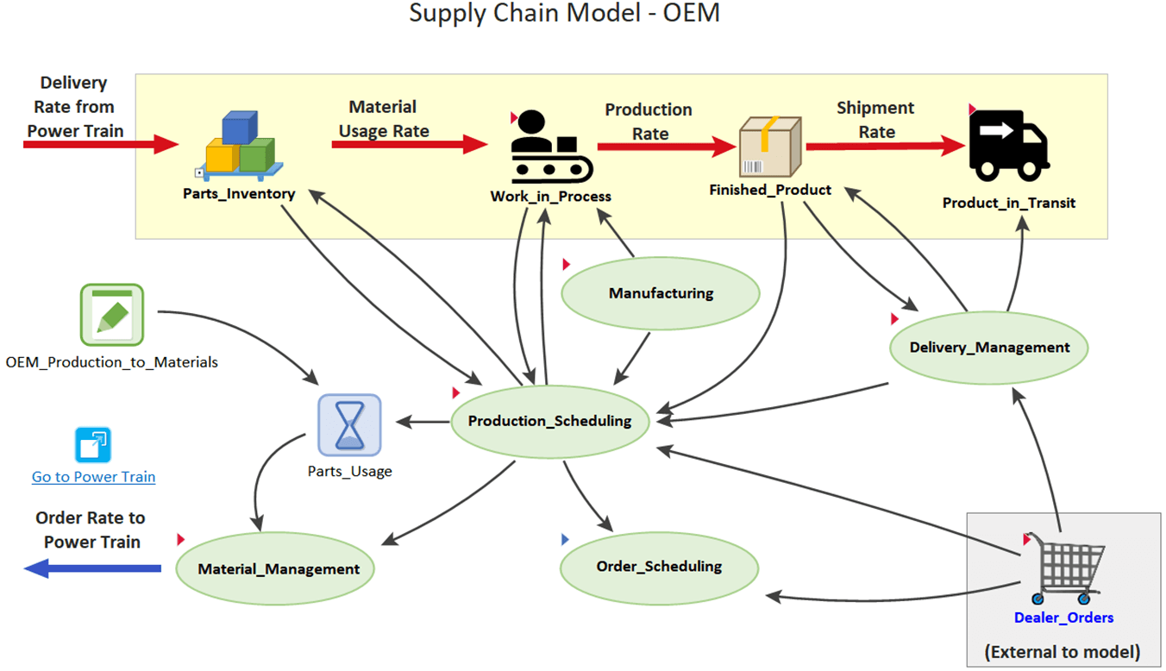
Supply Chain Technology
Complementary Supply Chain Technologies
Simulation Modeling
https://www.goldsim.com/web/applications/areas/businesssystems/supplychain/

Slide 44
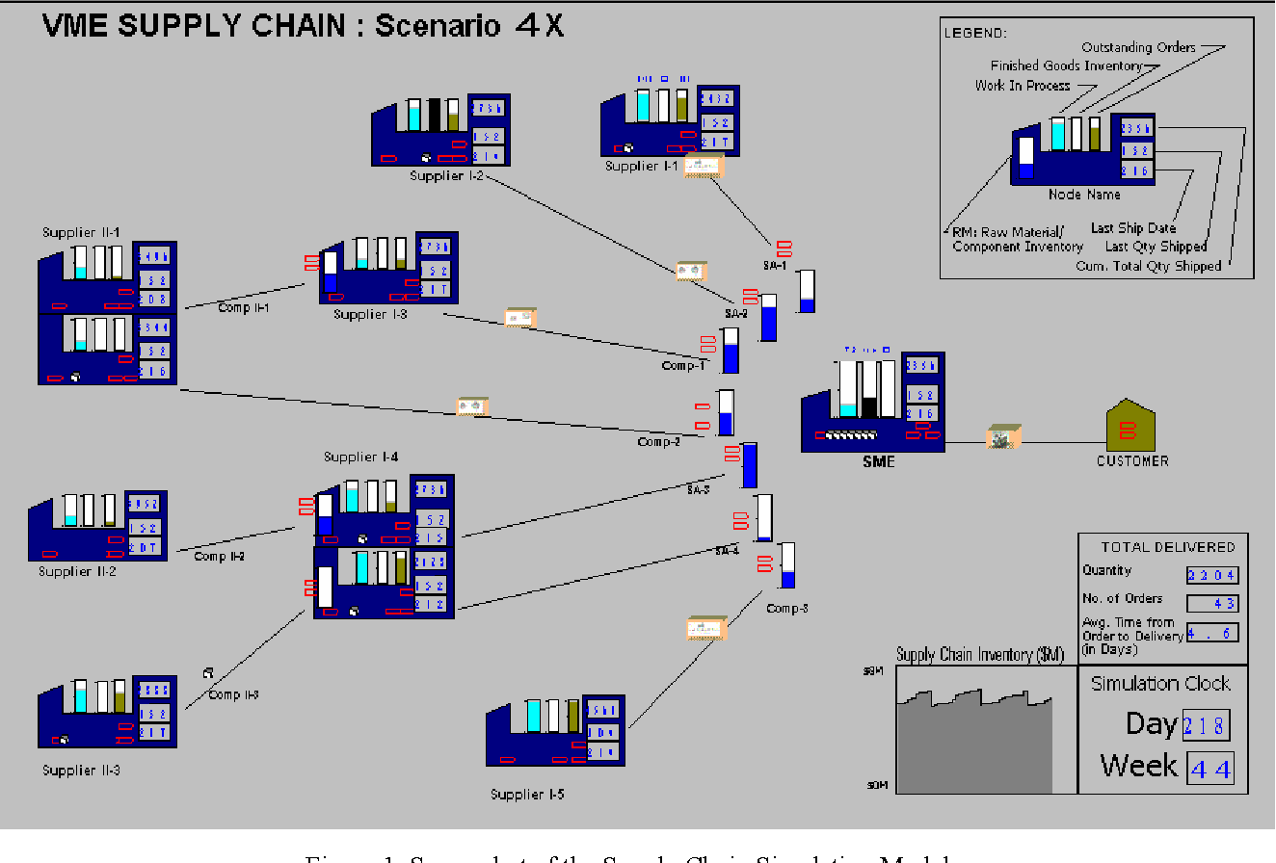
Supply Chain Technology
Complementary Supply Chain Technologies
Simulation Modeling
Stress testing a supply chain using simulation, Sanjay Jain, Swee Leong, 2005 in Proceedings of the Winter Simulation Conference.

Slide 45
Supply Chain Technology
Strategic Supply Chain Design
Which product must be produced in which unit?
Where should I build an new DC?
Where to locate the inventories and how much to guarantee a certain service level?
What is the most carbon-efficient network?

Slide 46
Supply Chain Technology
Strategic Supply Chain Design
Is it better to build on demand or to build on stock?
What is the impact of adding a new product in my supply chain?
What is the impact of reduced portfolio complexity?
How much safety stock should I hold?

Slide 47
Supply Chain Technology
Use of Simulation for Tactical Planning
Uncertainty is driven by
Demand uncertainty
Complex operations
Capacities
Equipment availability
Downtime
Simulation models help managers measure the consequences of these different types of uncertainty

Slide 48
Supply Chain Technology
Impact on Supply Chain Operations
True potential is realized when supply chain technologies are used in conjunction with others.
Companies have the opportunity to design extraordinary supply chains based on combinations of technologies
Companies and alliances of companies can collaborate and create a new breed of supply chains.

Slide 49
Supply Chain Technology
Assessing Technology and System Needs
Keep in mind the reason for using various technologies
Technology is not an end in itself
Technology is only as impressive as it delivers goods and services to customers on-time and at a competitive price
Poor technology decisions can be hugely impactful to a company

Slide 50
Supply Chain Technology
E-Business and Supply Chain Integration
Four key dimensions to integrate and coordinate:
Information integration – Sharing relevant information throughout the supply chain
Planning synchronization – Joint participation of companies in the supply chain in demand and inventory planning
Workflow coordination – Streamlining solutions across activities and companies
New business models – Emerge as a result of supply chain integration, cloud computing, etc.

Slide 51
Supply Chain Technology

Slide 52
Supply Chain Technology

Slide 53
Supply Chain Technology

Slide 54
Establishing the Decision Framework

Slide 55
Establishing the Decision Framework
Many scientists apply methodology without truly understanding the problem or environment
This process requires a clear understanding of the following:
The characteristics of the organization
Specific decisions that need to be made
Environmental and operating constraints
Decision variables
Measures of success

Slide 56
Groundwork
Seven Rules for Building Effective Decision Making Models
Rule 1: Select the methods that the decision maker can understand
Rule 2: The decision process must be easy to use
Rule 3: The model must fit the time frame available for development
Rule 4: The model must be adaptable to an ever-changing corporate environment
Rule 5: The model must be linked to achieving the corporate objectives
Rule 6: Lack of data can be supplemented with expert opinion
Rule 7: Definition of the optimal solution

Slide 57
Establishing Goals and Objectives

Slide 58
Establishing Goals and Objectives
Clear objectives, decision criteria, metrics, should answer the following:
Where we are going as a corporation?
What are we trying to accomplish at each level of the corporation?
How can we measure our progress in achieving these objectives?

Slide 59
Establishing Goals and Objectives
Defining Goals and Objectives of a Company
Use Decision Science (Group Decision Making) methods to facilitate this process
Objectives should represent current thinking
Goals and objectives should be integrated into decision processes at all levels of the organization
Objectives should represent a group consensus from senior-level management

Slide 60
Establishing Goals and Objectives
Service companies:
Improve contract performance
Minimize operating costs
Improve customer management
Manufacturing companies:
Improve contract performance
Minimize operating costs
Improve customer management
Distribution companies:
Minimize operating costs
Reduce inventory levels
Improve operating cycle time
Insurance companies:
Maximize customer service
Streamline information technology
Improve service delivery margins
Food Industry companies:
Improve profitability
Increase market share
Increase sales
Reduce manufacturing costs
Reduce distribution costs

Slide 61
Establishing Goals, Decision Criteria and Metrics
Establishing Goals, Decision Criteria and Metrics
The steps involved in this approach are as follows:
Step 1. Establish overall objectives and goals.
Step 2. Weight the objectives to determine their importance.
Step 3. Select the decision criteria.
Step 4. Weight the decision criteria.
Step 5. Develop metrics.

Slide 62
Establishing Goals and Objectives
Establishing Goals, Decision Criteria and Metrics
Step 1. Establish overall objectives and goals.
Determine an initial set of goals and objectives.
Refine goals and objectives based on group input.
Adapt objectives yearly to reflect changes to corporate strategy.

Slide 63
Establishing Goals and Objectives
Company Example
Use this process to provide a clearer strategic direction to the activities of the company
Align resource investment in products and projects with their corporate objectives
The company has indicated three corporate objectives
Improve financial position
Enhance technology development
Improve market position

Slide 64
Establishing Goals and Objectives
Group Decision Making Methods Used in the Process
Expert judgment and group consensus methods are commonly utilized in group decision-making.
Creative methods used to extract, generate, and stimulate new ideas may include brainstorming, brainwriting or Nominal Group technique.
Techniques that are used to explore and clarify existing issues might include surveys, conferences, and the SPAN technique.

Slide 65
Establishing Goals and Objectives
Company Example
Objectives | Definitions
Improve Financial Position | Improve the financial position by evaluating the project or product's financial contribution to the company.
Enhance Technology Development | Improve the technological position by evaluating the project or product's ability to meet the technology development and innovation needs of the company and customers.
Improve Market Position | Improve the market position of the company with this product or project.

Slide 66
Develop Decision Criteria and Metrics
Establishing Goals, Decision Criteria and Metrics
Step 2. Weight the objectives to determine their importance.
Weight the importance of the goals and objectives.
Use group decision-making techniques to facilitate.
Resulting weights should reflect the overall group consensus.

Slide 67
Establishing Goals and Objectives
Weight the Objectives to Determine Their Importance
Many times goals and objectives can be stated as being important but are not quantified.
There are typically conflicting objectives where the improvement in one area adversely impacts another.
Group consensus weighting provides input for each decision maker.

Slide 68
Establishing Goals and Objectives
Weight the Objectives to Determine Their Importance
Example
Weights | Objectives | Definitions
40% | Improve Financial Position | Improve the financial position by evaluating the project or product's financial contribution to the company.
20% | Enhance Technology Development | Improve the technological position by evaluating the project or product's ability to meet the technology development and innovation needs of the company and customers.
40% | Improve Market Position | Improve the market position of the company with this product or project.

Slide 69
Establishing Goals and Objectives
Experts Judgment/Group Participation
Objectives | Member 1 | Member 2 | Member 3 | Member 4 | Member 5 | Consensus
Improve Financial Position | 40% | 50% | 40% | 60% | 30% | 44%
Enhance Technology Development | 30% | 20% | 50% | 30% | 40% | 34%
Improve Market Position | 30% | 30% | 10% | 10% | 30% | 22%

Slide 70
Developing Decision Criteria and Metrics

Slide 71
Develop Decision Criteria and Metrics
Establishing Goals, Decision Criteria and Metrics
Step 3. Select the decision criteria.
Develop a hierarchy of decision criteria to represent the objectives.
Clearly define the decision criteria.
Use group decision making techniques.

Slide 72
Decision Criteria Development
Ensuring well-structured decision criteria
Goals and decision criteria must represent actual and important considerations in making decisions.
Decision criteria must differentiate one project from another in terms of higher or lower priority.
Decision criteria must be independent to avoid accounting for the same thought more than once.
Decision criteria must be clearly defined.

Slide 73
Decision Criteria Development
Ensuring well-structured decision criteria
Measures and scales developed for the decision criteria must be meaningful and the data easily accessible.
Objective criteria - Data is a basis for a relatively clear measure.
Subjective criteria - Scale components must be well defined and represent a natural language meaning
Constraints must be differentiated from the evaluation decision criteria.

Slide 74
Hierarchical Decision Criteria
A hierarchy tree of attributes
Goals and objectives can have a number of decision criteria that support them
There can be multiple levels of criteria
This hierarchy helps to define specific metrics that support accomplishing objectives
X
x₁
x₁₁
x₁₂
x₂
x₂₁
_{x3}
_{x4}
_{x5}
_{x33}
_{x31}
_{x32}
x₂₂
_{x41}
_{x42}
_{x53}
_{x51}
_{x52}

Slide 75
Develop Decision Criteria and Metrics
Select the decision criteria
Objectives | Decision Criteria
Improve Financial Position
 | Return on Resources Invested
 | Impact on Operating Cost
 | Net Present Value
Enhance Technology Development
 | Probability of Technological Success
 | Technology Development Requirements
 | Innovation
Improve Market Position
 | Market Size
 | Market Growth Potential
 | Market Attractiveness

Slide 76
Develop Decision Criteria and Metrics
Define the decision criteria
Objectives | Decision Criteria | Definitions | Objective or Subjective Data for Metrics
Improve Financial Position |  | Improve the financial position by evaluating the project or product's financial contribution to the company.
 | Return on Resources Invested | Projected return on the resources invested in the product or project. | Objective
 | Impact on Operating Cost | An assessment of how this product or project will impact operating costs. Scaled assessment of negative impact (increase) , neutral or positive impact (reduce). | Subjective
 | Net Present Value | The Net Present Value of the product or project using the company's discount rate. | Objective
Enhance Technology Development |  | Improve the technological position by evaluating the project or product's ability to meet the technology development and innovation needs of the company and customers.
 | Probability of Technological Success | An assessment of the probability of the successful development of this technology. | Subjective
 | Technology Development Requirements | An assessment of whether the development of this technology requires new products or processes or whether it can be accomplished with currently available capital assets or technologies | Subjective
 | Innovation | Is this an innovative technology, enhancement to current technology or are similar to currently available technologies. | Subjective
Improve Market Position |  | Improve the market position of the company with this product or project.
 | Market Size | The projected market size of this product or project. | Subjective
 | Market Growth Potential | The potential impact that this product or project has on market growth. | Subjective
 | Market Attractiveness | The market attractiveness of this product or project. This is a subjective assessment but should be based on market research. | Subjective

Slide 77
Develop Decision Criteria and Metrics
Establishing Goals, Decision Criteria and Metrics
Step 4. Weight the decision criteria.
Weight the importance of the decision criteria.
Use group decision-making techniques to facilitate.
Resulting weights should reflect the overall group consensus.

Slide 78
Develop Decision Criteria and Metrics
Weight the decision criteria.
Objectives | Decision Criteria | Member 1 | Member 2 | Member 3 | Member 4 | Member 5 | Consensus
Improve Financial Position
 | Return on Resources Invested | 30% | 20% | 25% | 40% | 15% | 26%
 | Impact on Operating Cost | 40% | 60% | 40% | 30% | 35% | 41%
 | Net Present Value | 30% | 20% | 35% | 30% | 50% | 33%
Enhance Technology Development
 | Probability of Technological Success | 45% | 30% | 35% | 45% | 40% | 39%
 | Technology Development Requirements | 30% | 40% | 25% | 25% | 35% | 31%
 | Innovation | 25% | 30% | 40% | 30% | 25% | 30%
Improve Market Position
 | Market Size | 20% | 30% | 35% | 40% | 35% | 32%
 | Market Growth Potential | 50% | 25% | 35% | 30% | 35% | 35%
 | Market Attractiveness | 30% | 45% | 30% | 30% | 30% | 33%

Slide 79
Develop Decision Criteria and Metrics
Generate group consensus weighting
Objective Weights | Objectives | Decision Criteria Weights | Decision Criteria | Resulting Weight
40% | Improve Financial Position
 |  | 26% | Return on Resources Invested | 10%
 |  | 41% | Impact on Operating Cost | 16%
 |  | 33% | Net Present Value | 13%
20% | Enhance Technology Development
 |  | 39% | Probability of Technological Success | 8%
 |  | 31% | Technology Development Requirements | 6%
 |  | 30% | Innovation | 6%
40% | Improve Market Position
 |  | 32% | Market Size | 13%
 |  | 35% | Market Growth Potential | 14%
 |  | 33% | Market Attractiveness | 13%

Slide 80
Develop Decision Criteria and Metrics
Establishing Goals, Decision Criteria and Metrics
Step 5. Develop metrics
Identify metrics from the decision criteria.
Criteria can be either subjective or objective:
Subjective—Expert opinion with a subjective scale.
Quantitative/objective—Corporate databases and systems.
Define the decision criteria as a reference point for evaluation.
Develop group consensus with the decision criteria.

Slide 81
Data Used to Support Metrics
Data Used to Support Metrics
Development parameters for decision criteria and metrics:
Must represent actual considerations in decision making
Must differentiate one project from another in terms of priority
Must be independent and not overlapping to avoid double counting

Slide 82
Metrics for Measuring Success
Metrics for Measuring Success
Keep metrics to a meaningful minimum
Use to defend and justify decisions
Provide objective assessment toward goals
Use to validate process improvement
Driven naturally from the process in which the data is relevant
Should be easy to collect and measure

Slide 83
Develop Decision Criteria and Metrics
Develop metrics
Objectives | Decision Criteria | Definitions | Objective or Subjective Data for Metrics
Improve Financial Position |  | Improve the financial position by evaluating the project or product's financial contribution to the company.
 | Return on Resources Invested | Projected return on the resources invested in the product or project. | Objective - Percentage
 | Impact on Operating Cost | An assessment of how this product or project will impact operating costs. Scaled assessment of negative impact (increase) , neutral or positive impact (reduce). | Subjective - Based on projected operating costs
 | Net Present Value | The Net Present Value of the product or project using the company's discount rate. | Objective - Dollars
Enhance Technology Development |  | Improve the technological position by evaluating the project or product's ability to meet the technology development and innovation needs of the company and customers.
 | Probability of Technological Success | An assessment of the probability of the successful development of this technology. | Subjective - Percentage
 | Technology Development Requirements | An assessment of whether the development of this technology requires new products or processes or whether it can be accomplished with currently available capital assets or technologies | Subjective - Subjective scale addressing the ability to leverage existing technology or the requirement = 5 to develop new resources to support = 1.
 | Innovation | Is this an innovative technology, enhancement to current technology or are similar to currently available technologies. | Subjective - Subjective scale where technology is innovative = 5 or similar to available technologies = 1.
Improve Market Position |  | Improve the market position of the company with this product or project.
 | Market Size | The projected market size of this product or project. | Subjective - Scaled from Low = $5 million to High = $100 million
 | Market Growth Potential | The potential impact that this product or project has on market growth. | Subjective - Scaled from Flat/Negative = 1 to >20% = 5
 | Market Attractiveness | The market attractiveness of this product or project. This is a subjective assessment but should be based on market research. | Subjective - Scaled from Low = 1 to High = 5

Slide 84
Multiple Attribute Decision Making Methods

Slide 85
Multiple Attribute Decision Making Methods
Multiple Attribute Decision Making methods rank and evaluate alternatives based on a set of attributes.
Many methods exist, but, we will discuss methods that are
Easy to use
Easy to understand
Relatively well known and accepted

Slide 86
Simple Additive Weighting Method
The simple additive weighting method (SAW) is probably the best-known and widely used method of multiple attribute decision making.
The decision maker evaluates each attribute.
The attributes are assessed with consistent scales of values or are normalized to a dimensionless number.
The decision maker assigns importance weights to each attribute.
Alternatives are ranked and evaluated.

Slide 87
Simple Additive Weighting Method
The decision maker can then obtain a total score for each alternative simply by
Multiplying the scale rating for each attribute value by the importance weight assigned to the attribute
Summing these products over all attributes.
After the total scores are computed for each alternative, the alternative with the highest score is the one prescribed to the decision maker.

Slide 88
SAW Precautions
Important precaution when developing decision models:
Scaling
Scaling of criteria value can greatly influence the impact of single criteria and thus the ranking.
To avoid this problem, all values within a criterion are normalized.
Independence
Care should be taken so that all the criteria are independent, thus avoiding overweighing the effects of a single criterion.

Slide 89
SAW
Simple Additive Weighting - Weighted Average
Weighted Average score in the SAW is obtained by adding contributions from each attribute.
A common numerical scaling system such as normalization is required to permit addition among attribute values.
Value of an alternative can be expressed as:
V(a_{i}) = V_{i} =

Slide 90
SAW Example I
Raw Data
 | MINIMIZE | MAXIMIZE | MAXIMIZE | MAXIMIZE
Alternative | Price | Comfort | Performance | Design
A1 | 300 | 3 | 3 | 3
A2 | 250 | 3 | 2 | 3
A3 | 250 | 2 | 3 | 3
A4 | 200 | 2 | 3 | 2
A5 | 200 | 2 | 2 | 3
A6 | 200 | 1 | 3 | 3
A7 | 100 | 1 | 2 | 2

Slide 91
SAW Example I
Find Best Score Based on Minimizing or Maximizing
 | MINIMIZE | MAXIMIZE | MAXIMIZE | MAXIMIZE
Alternative | Price | Comfort | Performance | Design
A1 | 300 | 3 | 3 | 3
A2 | 250 | 3 | 2 | 3
A3 | 250 | 2 | 3 | 3
A4 | 200 | 2 | 3 | 2
A5 | 200 | 2 | 2 | 3
A6 | 200 | 1 | 3 | 3
A7 | 100 | 1 | 2 | 2
Best Score | 100 | 3 | 3 | 3

Slide 92
SAW Example I
Normalize the Decision Matrix
Minimized Attribute = min(x_{ij})/x_{ij}
Maximized Attribute = x_{ij}/max(x_{ij)}
 | MINIMIZE | MAXIMIZE | MAXIMIZE | MAXIMIZE
Alternative | Price | Comfort | Performance | Design
A1 | 0.333 | 1.000 | 1.000 | 1.000
A2 | 0.400 | 1.000 | 0.667 | 1.000
A3 | 0.400 | 0.667 | 1.000 | 1.000
A4 | 0.500 | 0.667 | 1.000 | 0.667
A5 | 0.500 | 0.667 | 0.667 | 1.000
A6 | 0.500 | 0.333 | 1.000 | 1.000
A7 | 1.000 | 0.333 | 0.667 | 0.667

Slide 93
SAW Example I
Weight the Attributes
Multiply the normalized weights by the attribute values for each alternative and sum across all attributes
 | Normalized Weights
 | 33.3% | 26.7% | 20.0% | 20.0%
 | MINIMIZE | MAXIMIZE | MAXIMIZE | MAXIMIZE
Alternative | Price | Comfort | Performance | Design
A1 | 0.333 | 1.000 | 1.000 | 1.000
A2 | 0.400 | 1.000 | 0.667 | 1.000
A3 | 0.400 | 0.667 | 1.000 | 1.000
A4 | 0.500 | 0.667 | 1.000 | 0.667
A5 | 0.500 | 0.667 | 0.667 | 1.000
A6 | 0.500 | 0.333 | 1.000 | 1.000
A7 | 1.000 | 0.333 | 0.667 | 0.667

Slide 94
SAW Example I
Normalized Decision Matrix and Attribute Scores
 | Normalized Weights
 | 33.3% | 26.7% | 20.0% | 20.0%
 | MINIMIZE | MAXIMIZE | MAXIMIZE | MAXIMIZE
Alternative | Price | Comfort | Performance | Design | Score
A1 | 0.333 | 1.000 | 1.000 | 1.000 | 0.778
A2 | 0.400 | 1.000 | 0.667 | 1.000 | 0.733
A3 | 0.400 | 0.667 | 1.000 | 1.000 | 0.711
A4 | 0.500 | 0.667 | 1.000 | 0.667 | 0.678
A5 | 0.500 | 0.667 | 0.667 | 1.000 | 0.678
A6 | 0.500 | 0.333 | 1.000 | 1.000 | 0.656
A7 | 1.000 | 0.333 | 0.667 | 0.667 | 0.689

Slide 95
SAW Example I
Alternative Ranking
Alternative | Score | Rank
A1 | 0.778 | 1
A2 | 0.733 | 2
A3 | 0.711 | 3
A4 | 0.678 | 6
A5 | 0.678 | 5
A6 | 0.656 | 7
A7 | 0.689 | 4

Slide 96
SAW Example II
When all attribute values have the same scaling, it is not necessary to normalize the scale.
You must reflect “bigger is better” or “smaller is better” in the scaling.
Different criteria weights can result in different rankings.
The weights are multiplied by the decision criteria values for each of the attributes for an alternative and are summed to represent a score for the alternative.

Slide 97
SAW Example II
 |  | Importance Weight
 |  | 10% | 25% | 20% | 15% | 30%
Alternatives | Development Cost | Development Cost | Inventory Investment | System Interface (Scale - 1 (low) to 5 (high)) | Transportation Cost | Economic Benefit | Score
 |  | (See Scale) | (Scale - 1 (low) to 5 (high)) |  | (Scale - 1 (low) to 5 (high)) | (See Scale)
System Enhancements | $8,000,000 | 1 | 3 | 5 | 3 | 4 | 3.5
Acquisition Improvements | $1,500,000 | 3 | 3 | 3 | 2 | 2 | 2.55
Transportation Optimization | $2,000,000 | 3 | 2 | 1 | 5 | 4 | 2.95
Repair Cost Reduction | $8,000,000 | 5 | 2 | 1 | 2 | 3 | 2.4
Economic Benefit Scale
1- very low <$500K
2 - low >=$500K to <$1M
3 - medium >=$1M to <$2.5M
4 - high>= $2.5M to <$5M
5- very high >=$5M
Development Cost Scale
5 - very low <$500K
4 - low >=$500K to <$1M
3 - medium >=$1M to <$2.5M
2 - high>= $2.5M to <$5M
1 - very high >=$5M

Slide 98
Sensitivity Analysis
Sensitivity Analysis
Sensitivity analysis is an important aspect of using structured methods in the decision-making process.
The initial solution is starting point in decision making.
The weights drive the product ranking and should not be overlooked.
Use group decision-making techniques to ensure that the weights are representative of the organization.

Slide 99
Sensitivity Analysis
Sensitivity Analysis
Testing the different rank order of products with different attribute weights can be done as part of sensitivity analysis with the solution.
Additionally, testing the modification of the individual attributes can provide decision makers with insight into how sensitive various values are to the resulting rank order.

Slide 100
Line Item Retention and Deletion
The decision process was used to determine which line items are to be deleted or retained from the product mix for a large food company
Using a wide range of conflicting criteria, the model was able to evaluate the current and proposed products, weight the decision criteria, rank the products, do sensitivity and what-if analysis
Regional differences and preferences were included in the model
The process helped management determine new product introductions

Slide 101
Line Item Retention and Deletion
Decision Criteria
FINANCIAL CRITERIA
Sales Volume
Dollar Profitability
Contribution to Margin
Obsolescence Costs
MARKETING CRITERIA
Future Potential Sales
Competitive Position
Replacement Potential
Product Line Position
Strategic Importance

Slide 102
Line Item Retention and Deletion
Decision Criteria
OPERATIONS CRITERIA
Impact on Overall Quality
Impact on Sales
Impact on Operating Costs
Impact on Production Capacity
TECHNOLOGY
Impact on Equipment

Slide 103
IMSE 802 Supply Chain Operations and Decision Making
Lecture 5
Chapter 4
Supply Chain Technology

